Slide 1
Trusted Hardware
Sai Krishna Deepak Maram, CS 6410

Slide 2

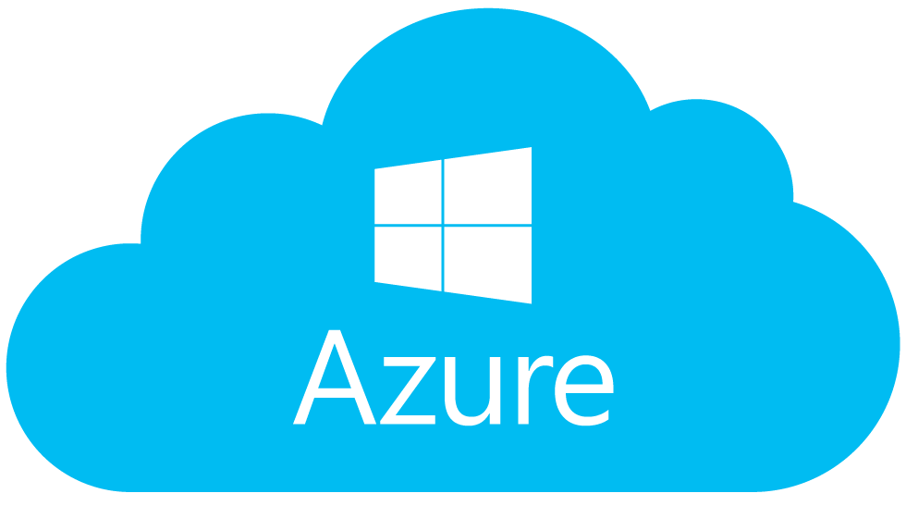

Move to a Cloud-based model
User apps
User apps
Software
PaaS Cloud Provider manages the stack
Software
Hypervisor
Hypervisor
OS
OS
Notes:
A traditional PaaS model. Applies to Saas, IaaS as well.

Slide 3
Move to a Cloud-based model
User apps
Privileged code
Software
Software
Malicious cloud provider?
Hypervisor
Hypervisor
OS
OS

Slide 4
Can you trust the cloud?
Huge Trusted Computing Base (TCB)
Cloud Provider’s software
Management stack
Sysadmins
Notes:
User needs to trust the cloud provider’s software, cloud sysad, even other cloud users co-located => large trusted computing base (TCB)

Slide 5
What do we want?
Notes:
Simply put, we want the raw resources of the cloud provider. Without trusting all the middlemen

Slide 6
Shielded Execution using SGX
Confidentiality: The execution state is unobservable to the rest of the system.
Integrity: If the program completes, its output is the same as a correct execution on a reference platform
SGX
Enclave
Privileged code
Software
Cloud Provider manages the stack
Hypervisor
OS
Notes:
At a high level, the abstraction we are looking for is that of “Shielded execution” - Irrespective of the environment, SGX provides a hardware-based guarantee of isolation.
the props we want are...

Slide 7
Is shielded execution sufficient?
Notes:
To complete this piece of puzzle i.e., trusted hardware, we need one final piece.
“An isolation mechanism must permit interaction with untrusted software or hardware, to communicate results or access system services, and it is at these points that a na¨ıve isolated program is vulnerable”

Slide 8
Remote attestation
Goal: Allow cryptographic verification that specific software has been loaded within an enclave
While an enclave is initialized, its contents is cryptographically hashed by the CPU forming the enclave’s measurement
Generated using a key burnt on the SGX chip
Root of trust: Intel
Intel attestation service (IAS) for verification
Enclave Initialization
Private key
SGX Chip
Intel
Private key
Public key
IAS
Measurement hash
Notes:
Allows for providing the end-to-end guarantee , Intel controls it

Slide 9
How does SGX achieve this?
Notes:
Let’s look a bit into the SGX internals

Slide 10
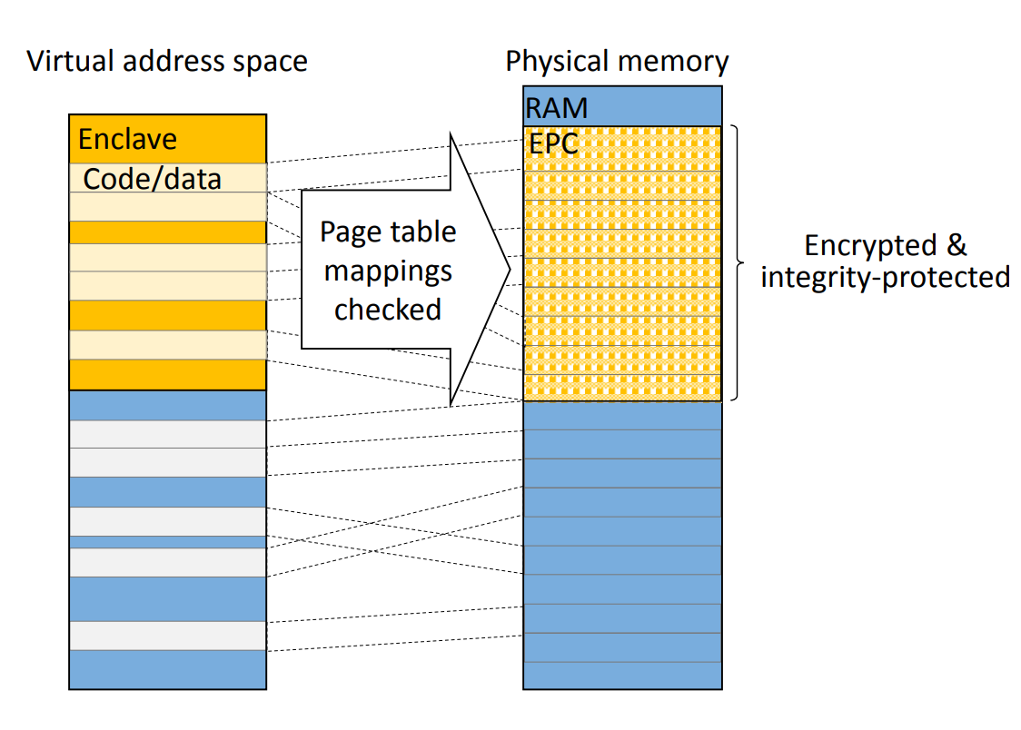
Memory protection
EPC (Enclave Page Cache)
A separate region in physical memory
All enclave pages reside here
Hardware tracks meta info corresponding to each page
Virtualized

Slide 11
Memory protection
EPC (Enclave Page Cache): A separate region in physical memory
Encrypted and integrity-protected before writing to the main memory
Same page table as the underlying OS
Access checks are performed to ensure any other application (not even other enclaves) can access an enclave’s data

Slide 12
Execution lifecycle (high-level)
Loading stage: Performed by untrusted code
Enclave is initialized by copying code/data into EPC Pages
At the end of which, contents are hashed to compute enclave’s measurement hash
Enclave mode:
Special instructions to create an enclave, add pages to enclave and exit an enclave
Similar to switching from user to kernel mode
Secure mechanisms to handle interrupts (or) page faults to protect from OS exception handlers

Slide 13
Before SGX?
Notes:
Architectures before SGX: Dedicated crypto hardware (not general-purpose), trusted hypervisors, TPM

Slide 14
Trusted Platform Module (TPM)
Attestation-based
Can be used with commodity systems
Weak security
Much bigger TCB than SGX: Measurement hash covers all the OS modules and device drivers
Very hard to keep an up-to-date list of the hashes
Many more attacks....

Slide 15
How to port legacy applications into SGX?
Notes:
Related question: How different is it to develop new applications in SGX?
Ask for any thoughts here?

Slide 16
Developing applications in SGX
Untrusting OS: Makes it harder
Any function call (or) syscall made outside the enclave are not guaranteed to return
Even if data returns, enclave cannot trust the data returned

Slide 17
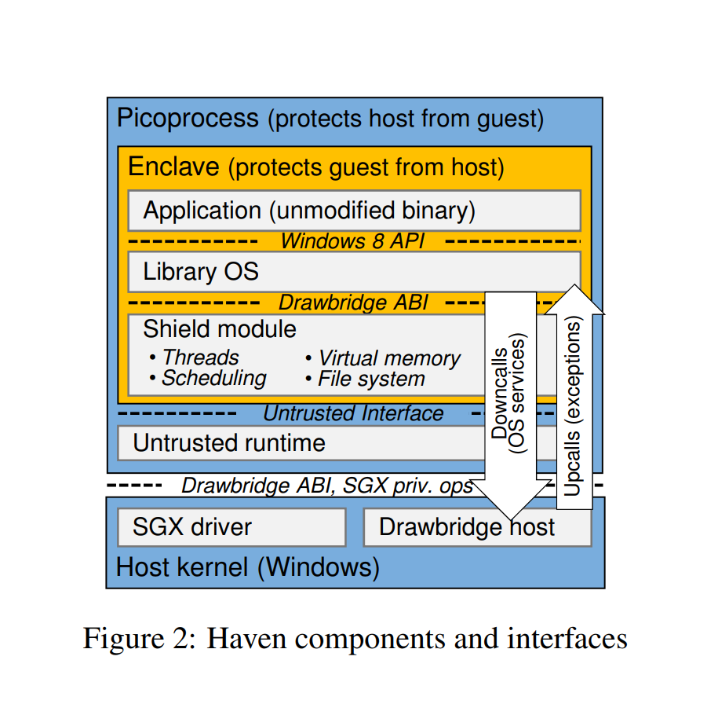
Haven
Haven design goals:
Mutual distrust b/w guest and host
Run legacy apps inside SGX without any modifications
Application interacts only with LibOS
Assumes libOS is carefully implemented
Shield module interacts with the untrusted host OS
Notes:
Exokernel connection: All OS apps at the user level.

Slide 18
How Haven handles Iago attacks
Iago attacks: “Malicious kernel attempts to subvert an isolated application by exploiting its assumption of correct OS behaviour, for example when using the results of system calls”
LibOS: Implement entire OS as part of the Trusted Computing Base. Limits the interaction of enclave app with the actual OS, thus reducing the attack surface.

Slide 19
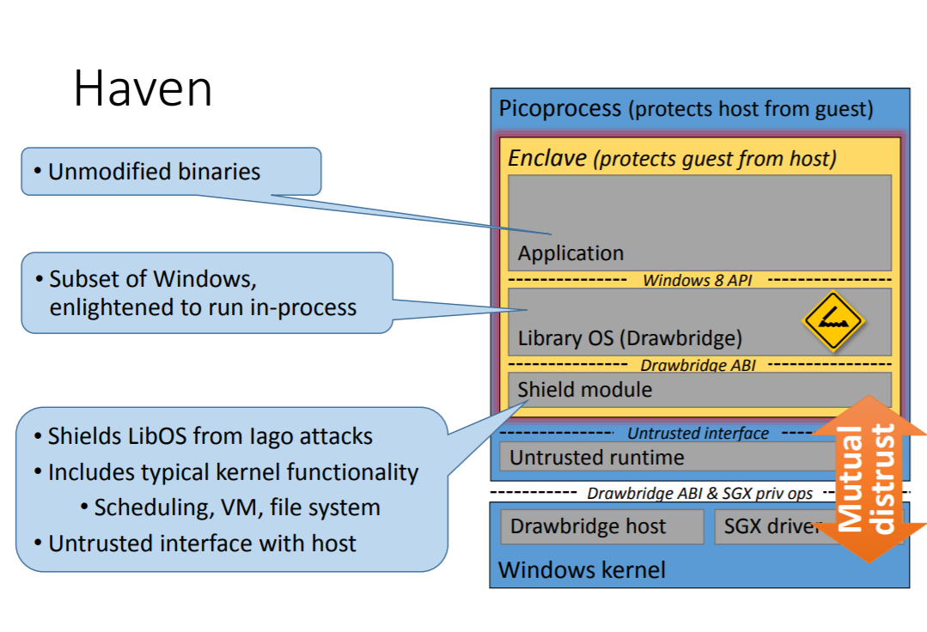

Slide 20
LibOS and Exokernels
Both bring OS level functionalities to the user space, but for what reasons?
Efficiency in Exokernel: “Move OS functionality to the user space to grant more flexibility”
Security in Haven’s LibOS: “Move OS functionality into the enclave to reduce attack space”
Notes:
libOS and exokernel

Slide 21
Haven Performance
35% - 65% slowdown
Depends on the exact use case
Notes:
The usual security vs efficiency tradeoff

Slide 22
Haven influencing SGX

Slide 23
Haven influencing SGX design
Dynamic memory allocation
SGX does not allow addition of enclave pages after the creation of enclave
Exception Handling
SGX does not allow handling of all exceptions
Some other limitations
Fixed in v2.0
Notes:
Mismatch b/w what Haven wants and SGX provides

Slide 24
SGX: What’s new?
Latest v2.3
Trusted randomness, other crypto operations
File abstractions inside an enclave
Baidu’s Rust SGX SDK
Dockerized
Runs a simulated version on machines without SGX chip as well

Slide 25
Is SGX secure?
Sophisticated side channel attacks
Foreshadow - Usenix’18
Speculative execution
Notes:
“Nothing is secure”

Slide 26
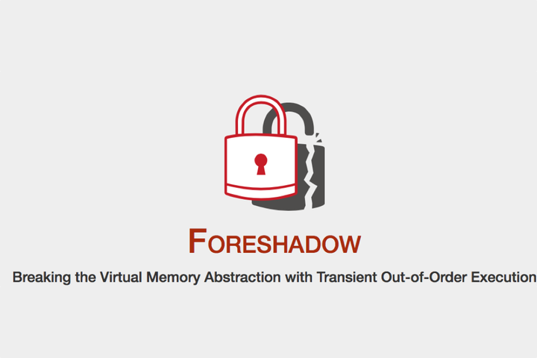
Trusted hardware makes the attacker’s job costly

Slide 27
Discussion
Haven
Exokernel connection to Haven
Impact of Haven and why it’s not more widely used?
SGX
Does trusted hardware solve the problem of security in the cloud?
Can SGX still be useful in face of side channel attacks?

Slide 28

Thank you!
References:
Haven, Slides
Intel SGX explained

